Slide 1

MovieLens
BIG DATA TOOLS & TECHNIQUES
Group 11
Gavriel Kirichenko, Callum Joseph Arul, Diparshan Bhattarai, Chia-Wei Chang, Bikash Giri, Friba Hussainyar, Hsi-Teng Liu, Sergio Alejandro Medrano Diaz, Abdul-Rasaq Omisesan,

Slide 2
Dataset Description
Size
100,000 ratings
943 users
1682 movies
Cleaning
Only users with 20+ ratings and complete demographic info are included
File format
.dat file
Data is randomly ordered

Slide 3
Introduction - Business Questions
Which movies are the most popular among different age groups?
Do male and female users have different rating preferences?
Which movie genres have the highest average ratings?
How are users’ ratings affected by movie release date?
How does movie rating behavior vary by user occupation?
Which users are most active in terms of number of ratings?

Slide 4
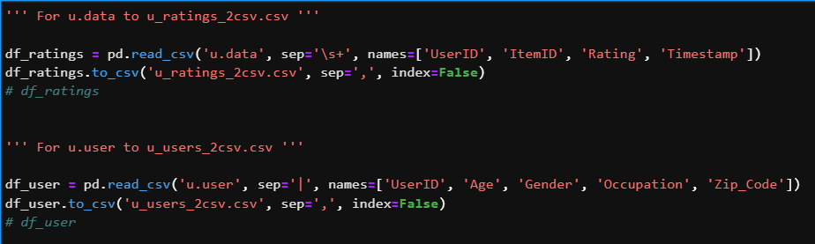
Step 0: Transform to CSV

Slide 5
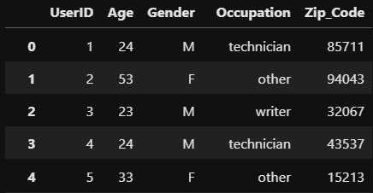
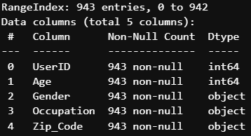
Pre-Process and Cleaning
Users:

Slide 6
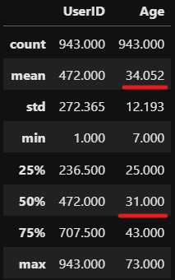
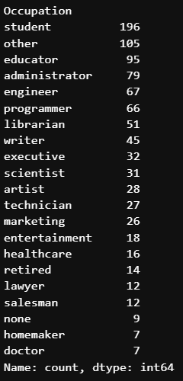
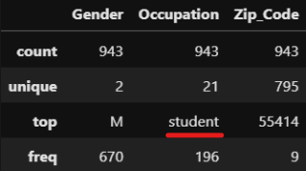

Slide 7
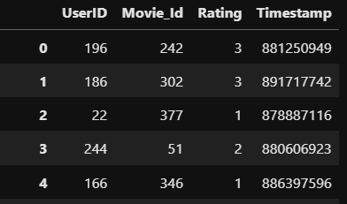

Ratings:

Slide 8
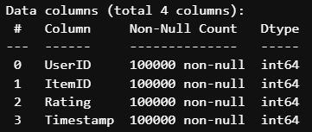
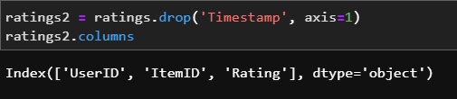

Slide 9

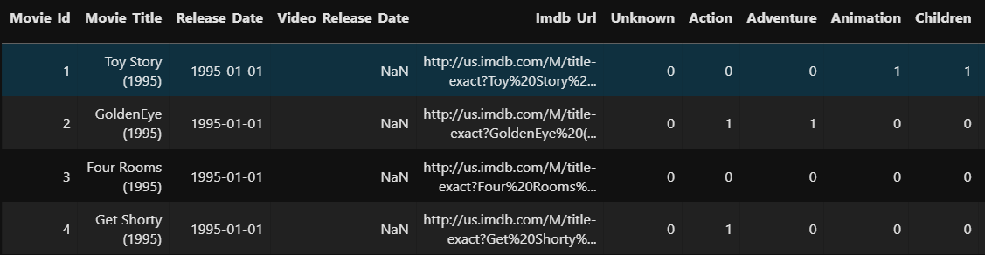
Movies:

Slide 10
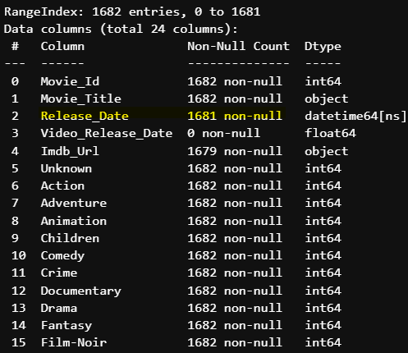
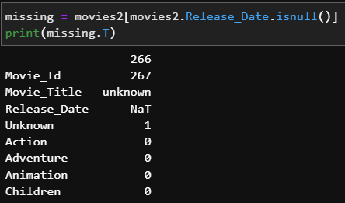
Notes:
Primary Key

Slide 11
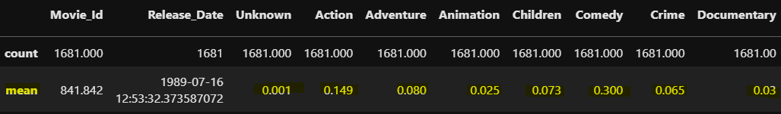


Slide 12
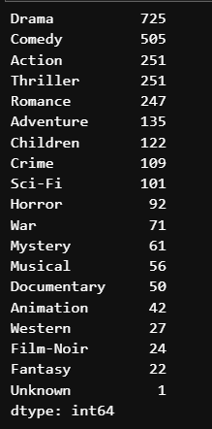
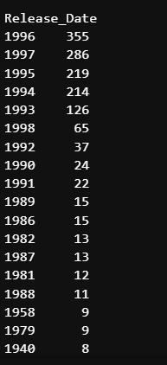

Slide 13
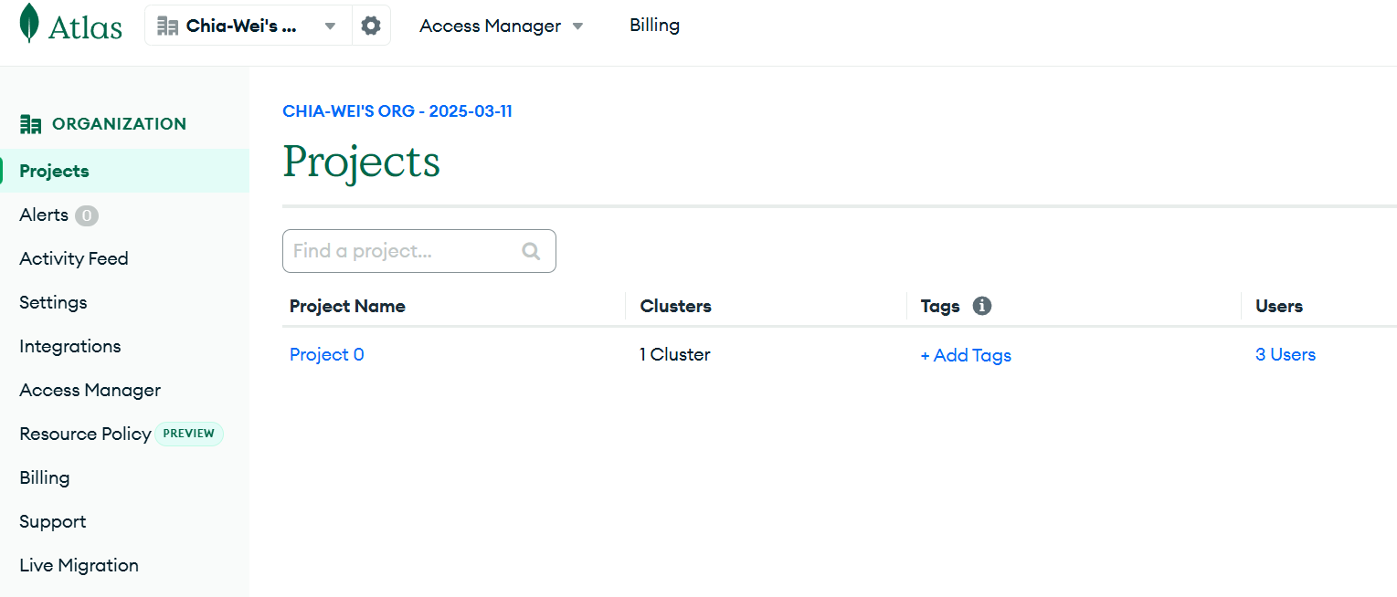
Import csv to mongodb
Create MongoDB Account

Slide 14
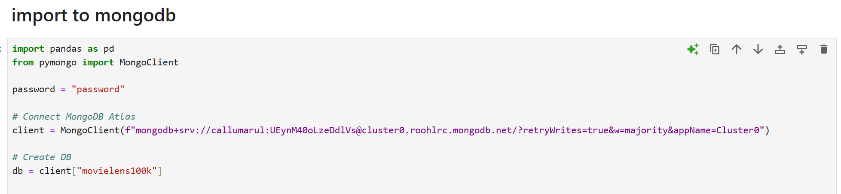
Import csv to mongodb
Open jupyter notebook
Use pymongo library
Connect MongoDB Atlas

Slide 15
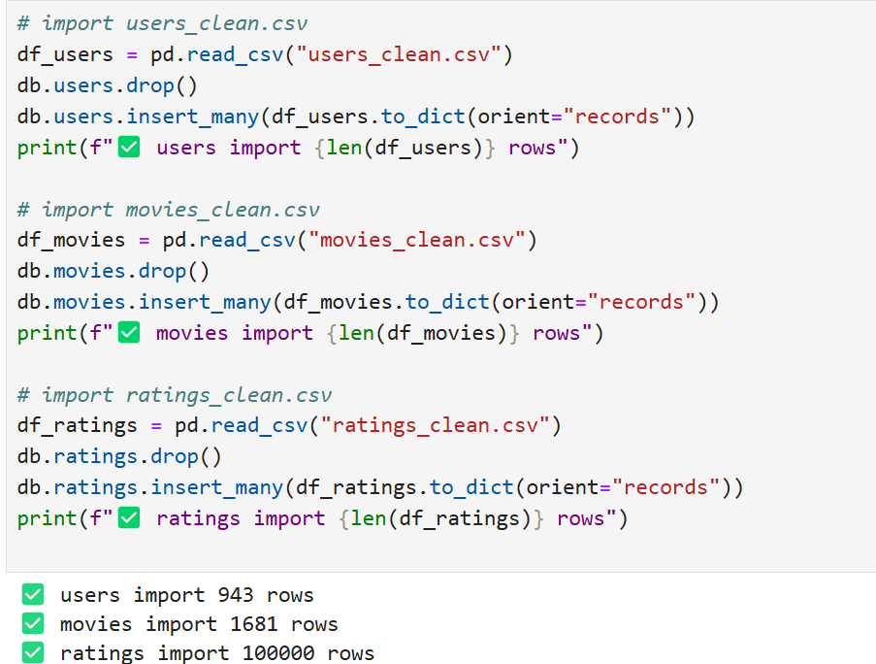
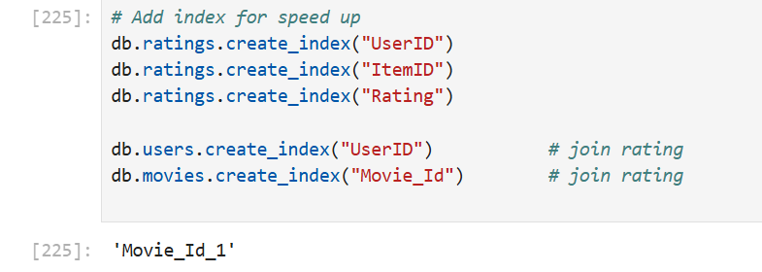
Import csv to mongodb
Import CSV Data to Mongodb using pymongo
Add index for table speed up analysis

Slide 16
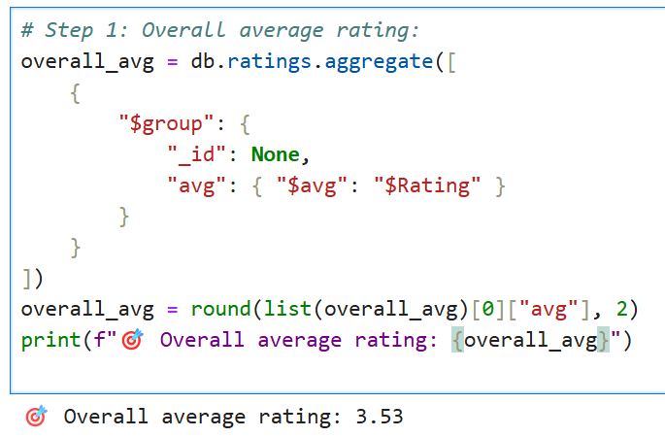
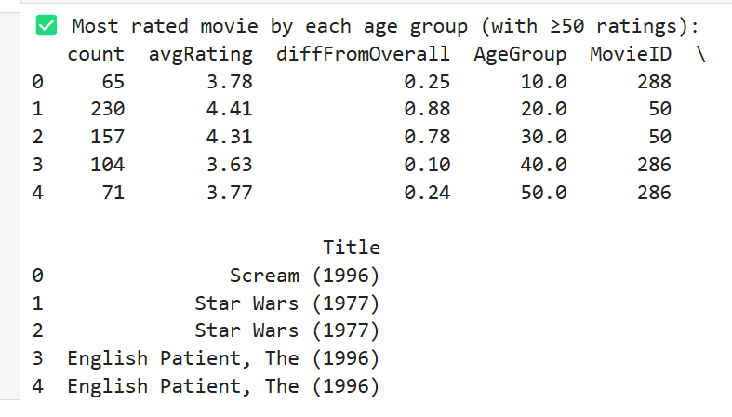
Data Analysis（Use MongoDB）
Most rated movie by each age group (with ≥50 ratings)
Overall average rating: 3.53

Slide 17
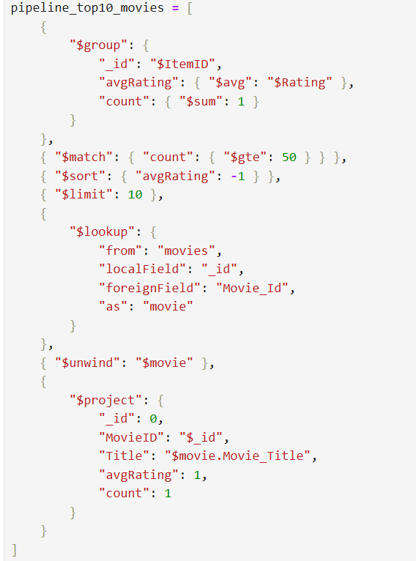
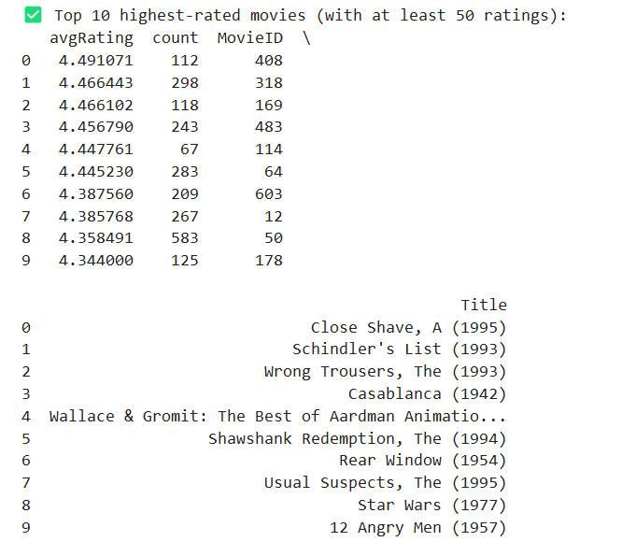
Data Analysis（Use MongoDB）
Top 10 highest-rated movies (with at least 50 ratings)

Slide 18
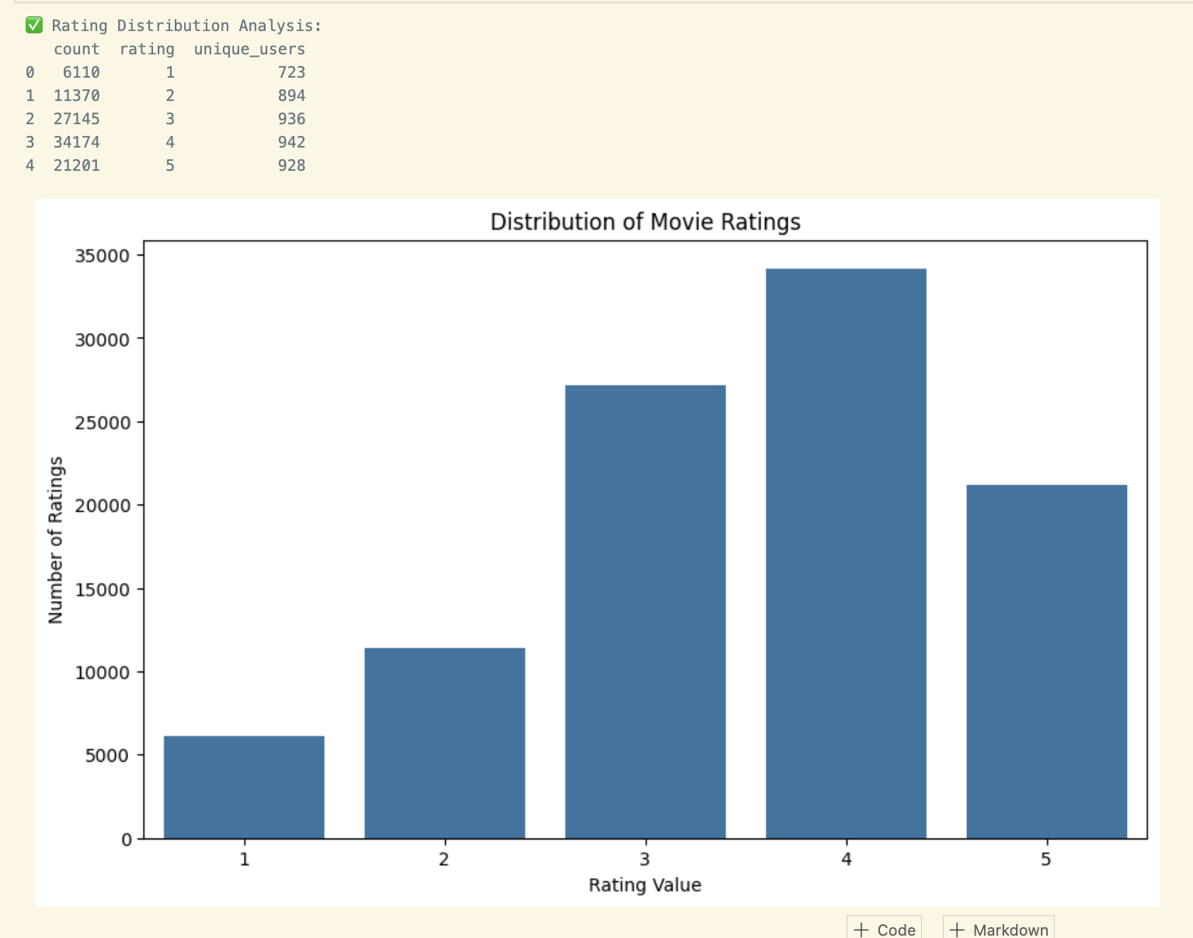
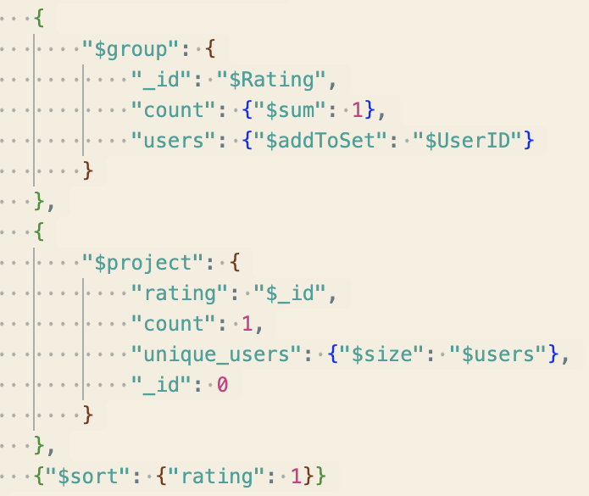
Rating Distribution Analysis

Slide 19
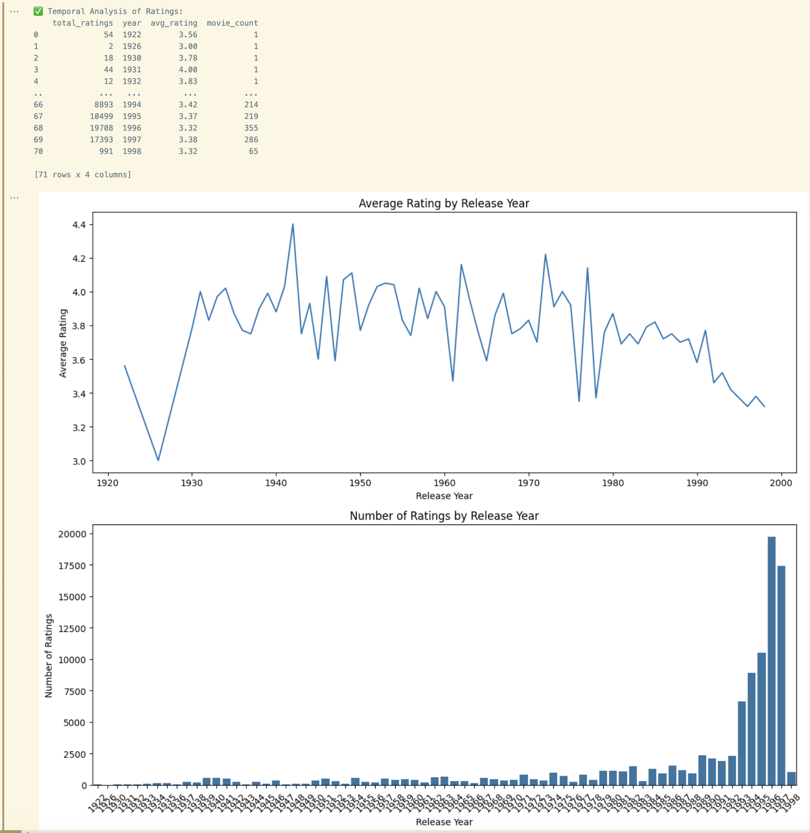
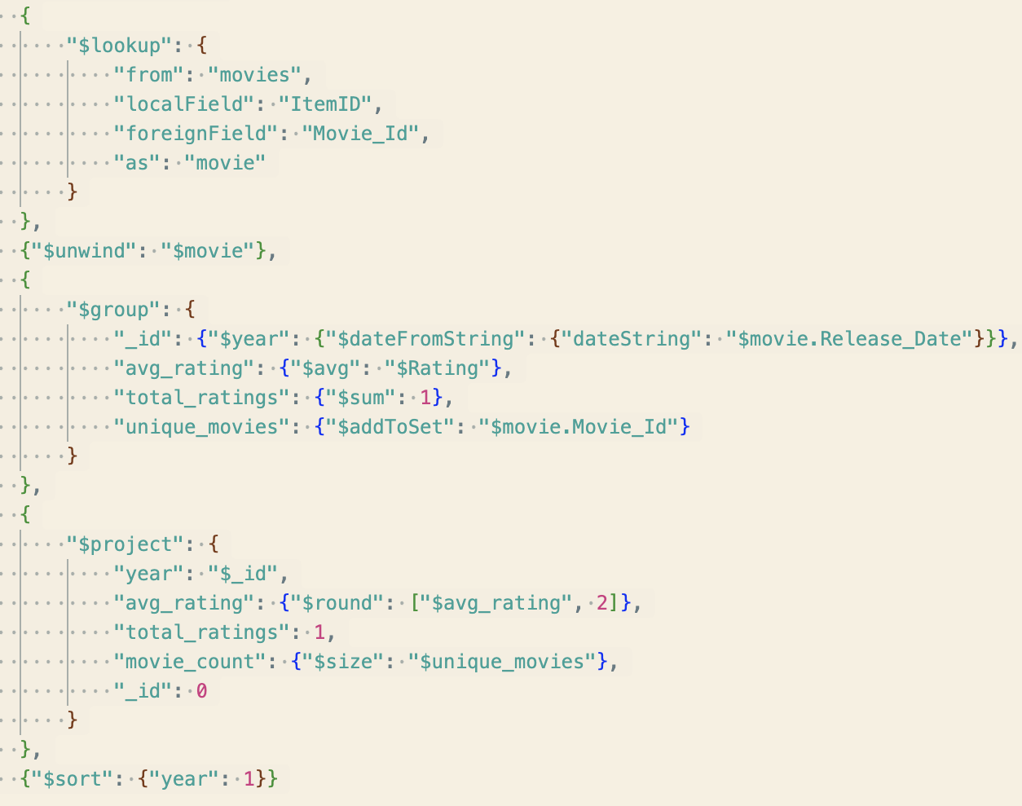
Temporal Analysis

Slide 20
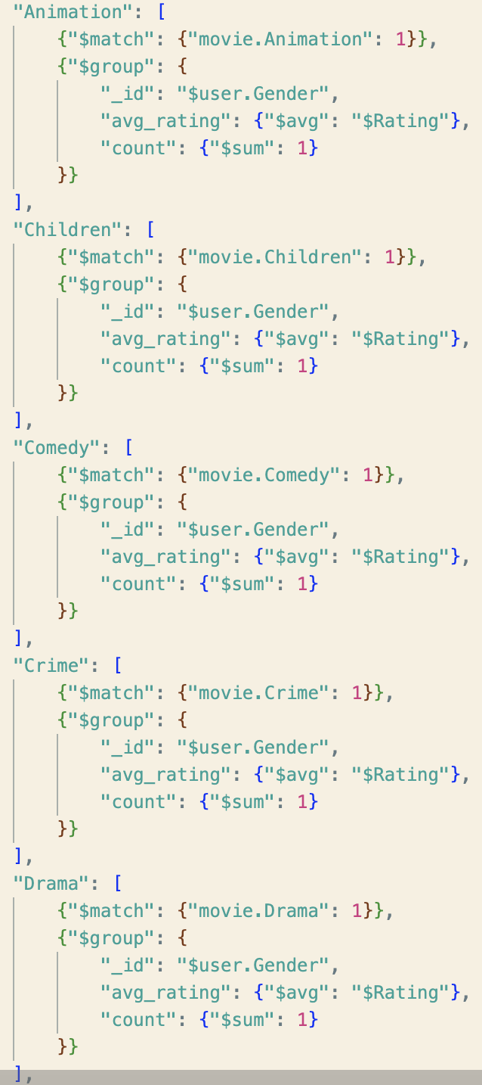
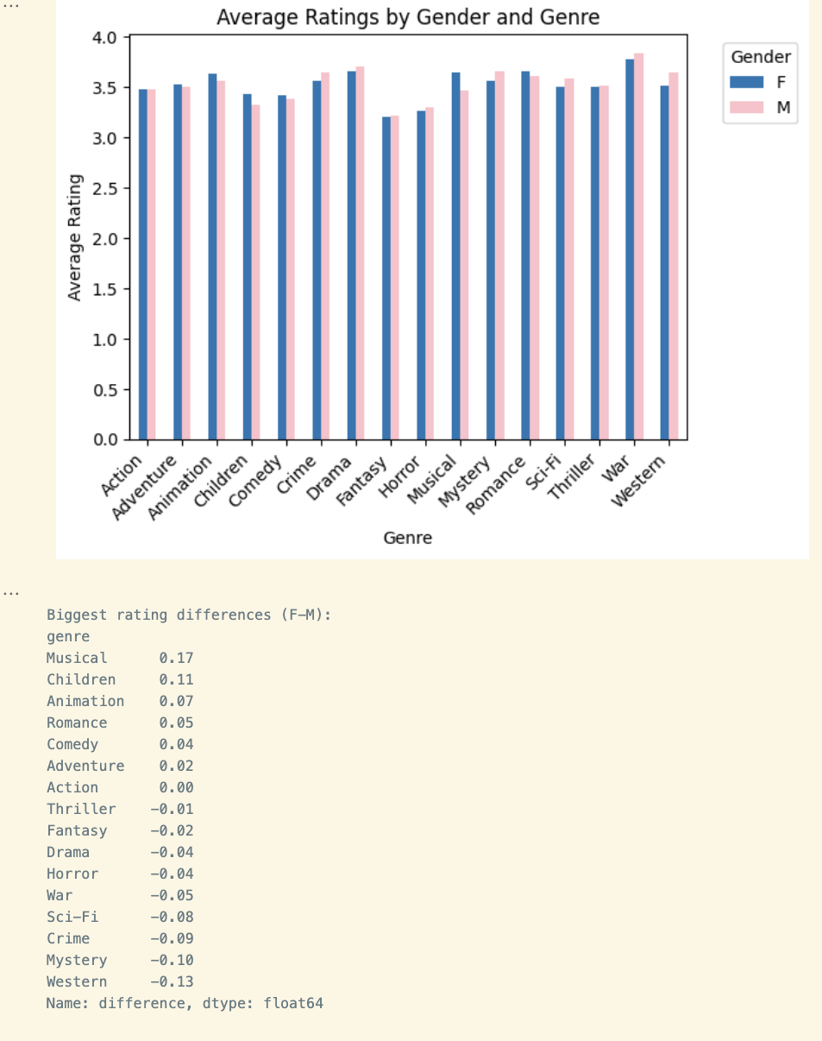
Gender-Based Movie Preferences Analysis

Slide 21
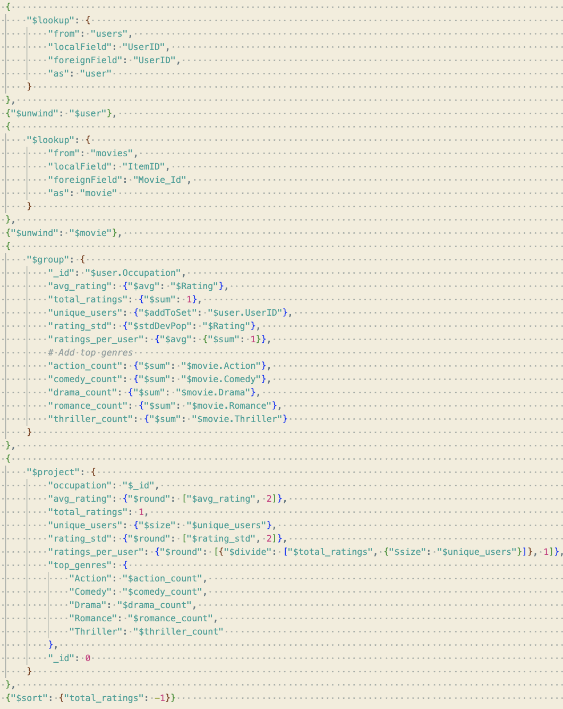
Occupation-Based Analysis

Slide 22
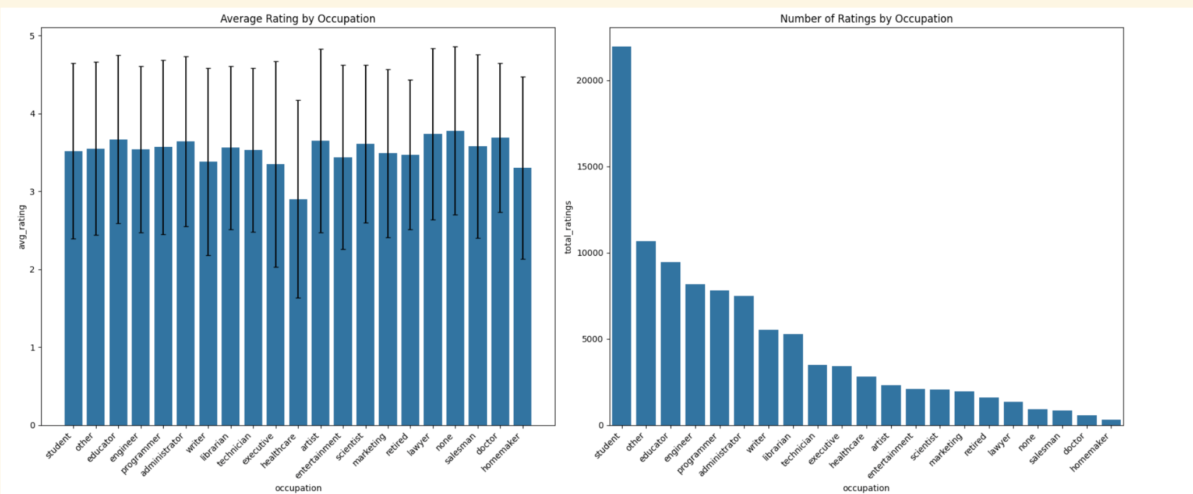
Occupation-Based Analysis

Slide 23
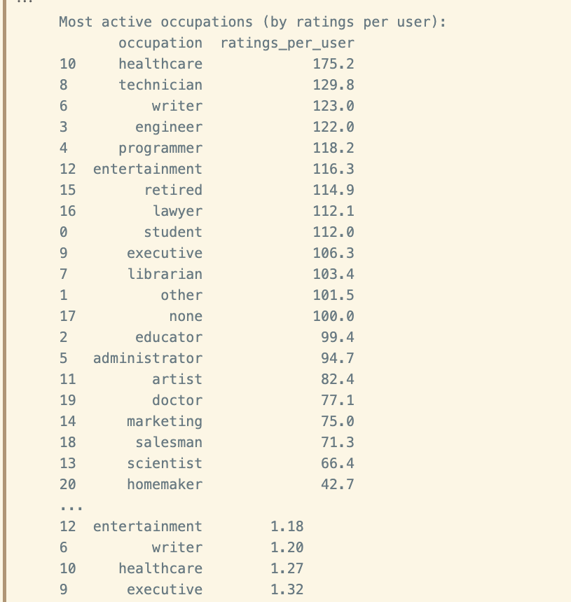
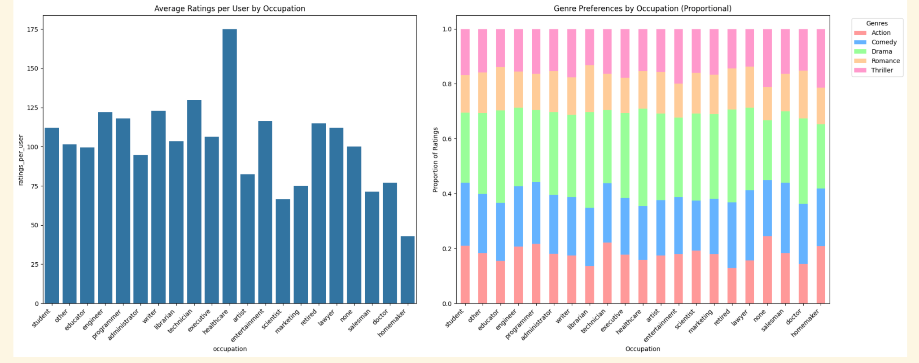
Occupation-Based Analysis

Slide 24
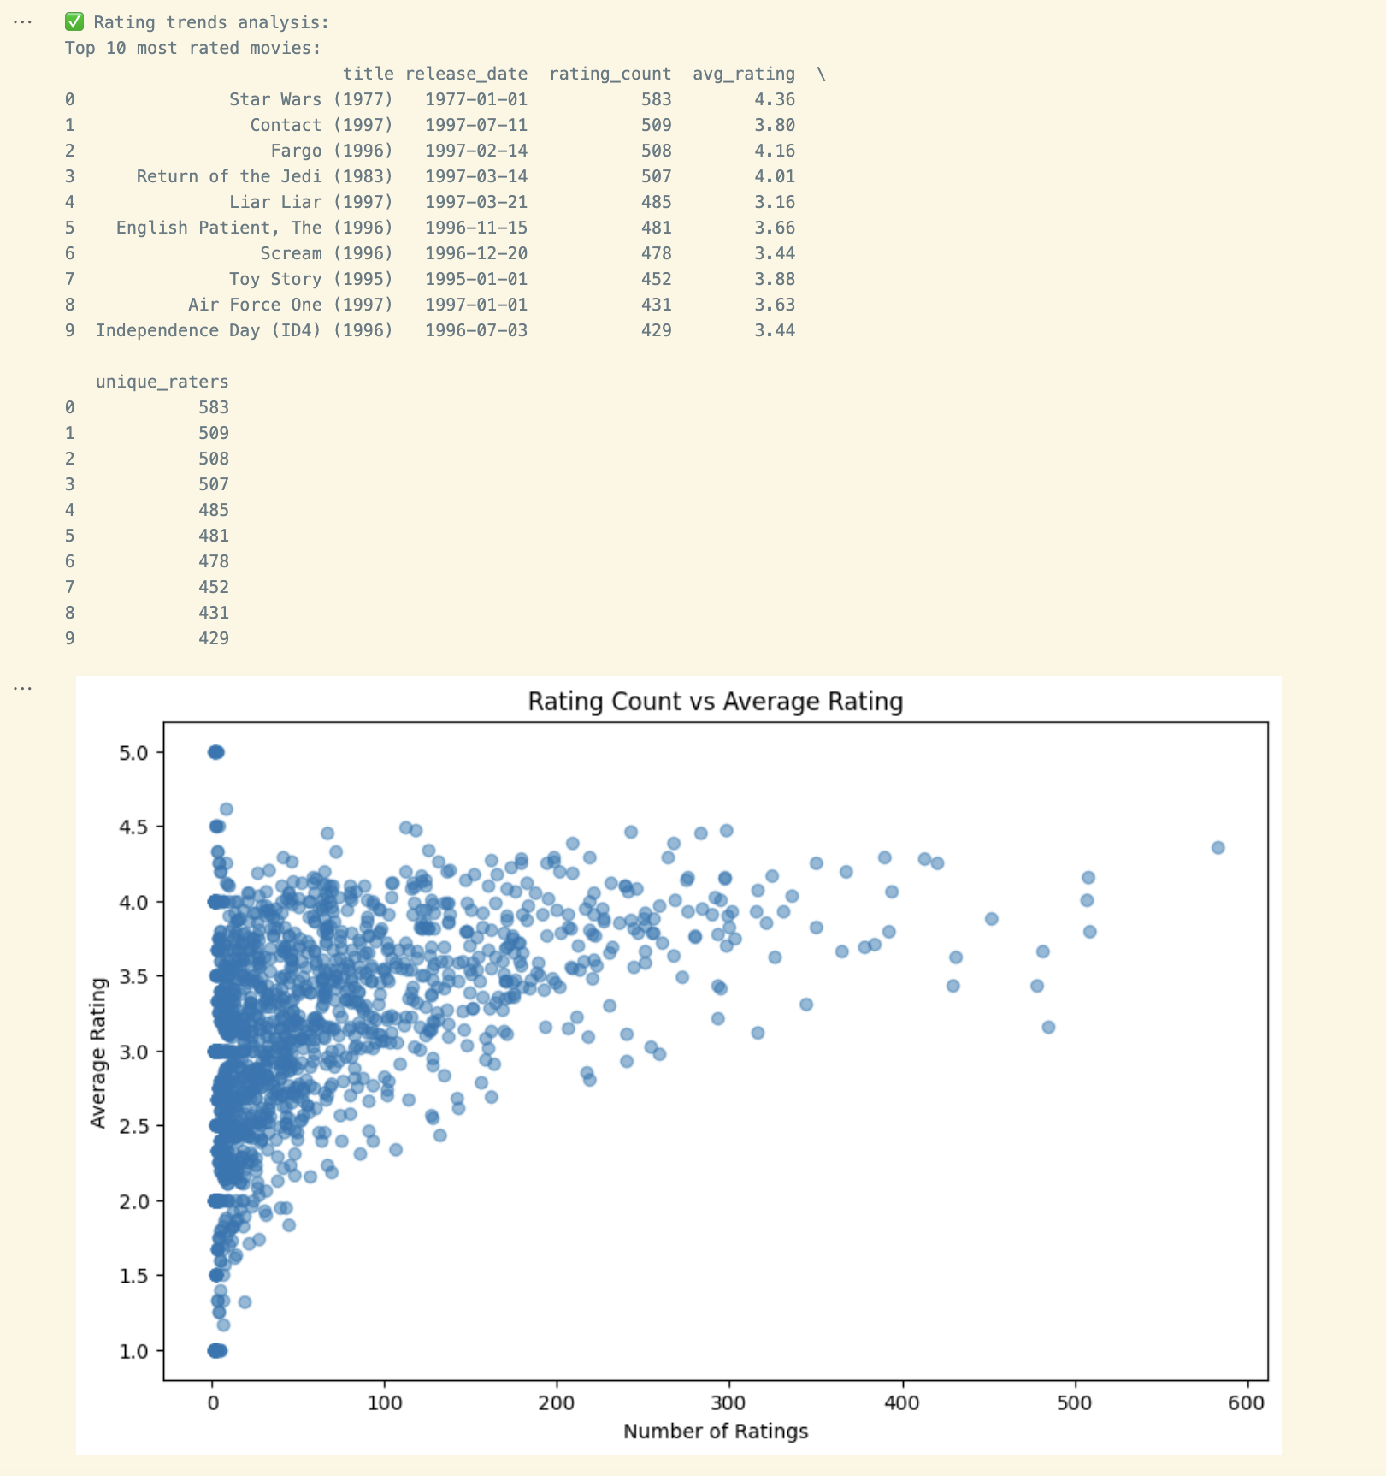
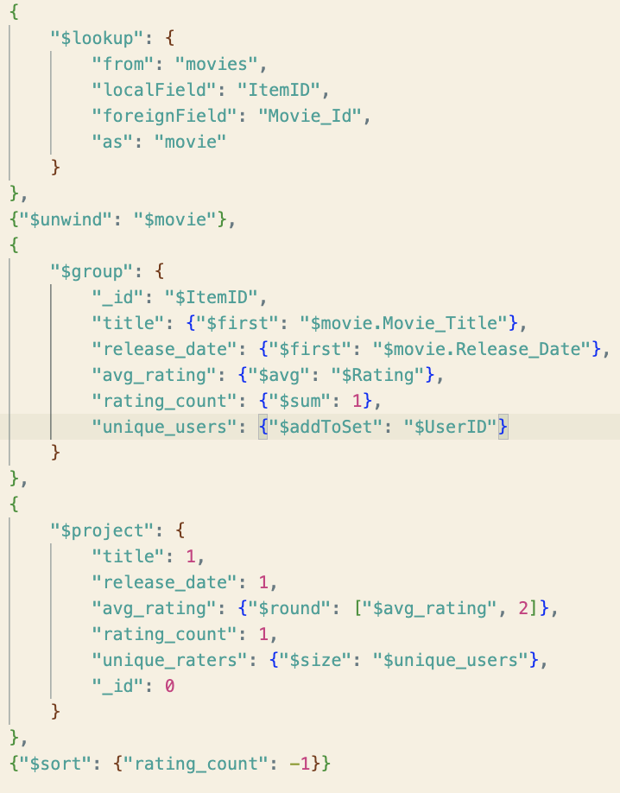
Rating Trends Analysis

Slide 25
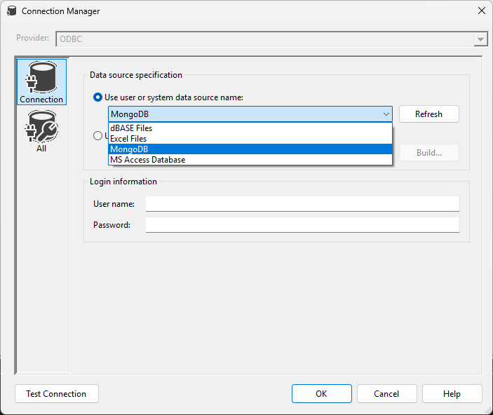
MongoDB to MS SQL
Mongo BI Connector provider a SQL daemon pairs with an ODBC driver.
Importing was possible in SSIS, but the transform to normalized forms was too difficult.

Slide 26
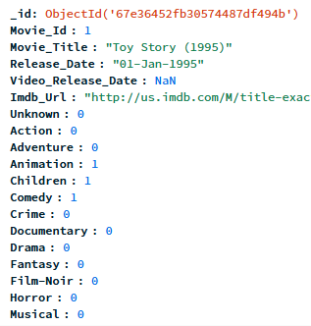
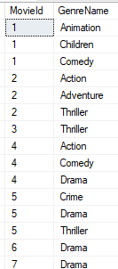
MongoDB to MS SQL
The Semi-Structured and Structured data mismatch

Slide 27
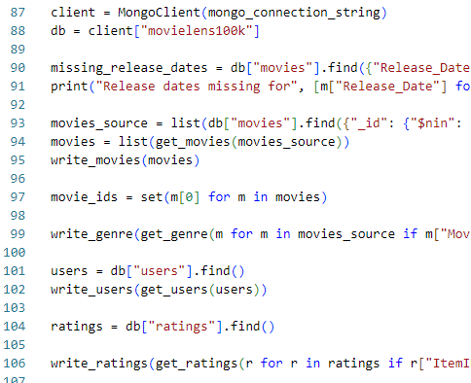
MongoDB to MS SQL
The Python Solution
PyMongo
PyODBC with fast_executemany

Slide 28
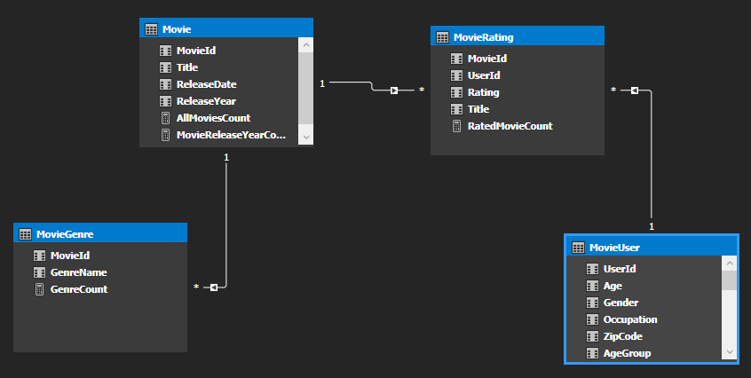
SSAS

Slide 29
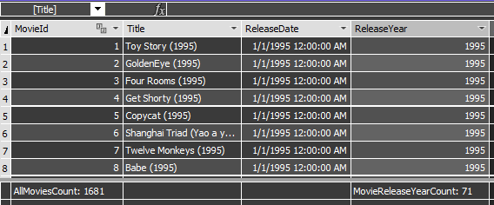
SSAS
Added Column
Metrics

Slide 30
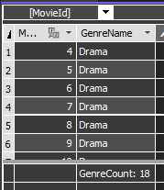
SSAS
Metric

Slide 31
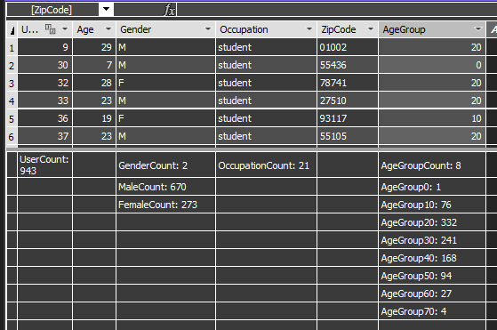
SSAS
Added Column
Metrics

Slide 32
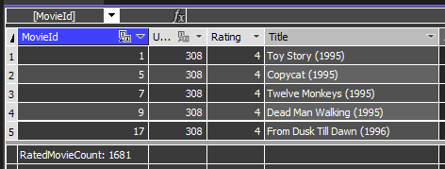
SSAS
Metric

Slide 33
PowerBI Exploration
1. User Demographics & Preferences Report
2. Movie Genre Popularity Report
3. Top-Rated Movies Report
4. Total Movies per Genre Report

Slide 34
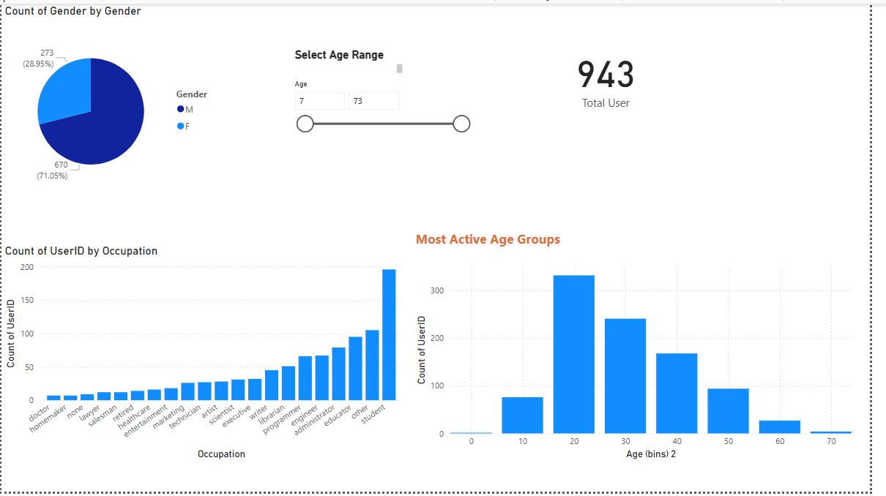
User Demographics & Preferences Report

Slide 35
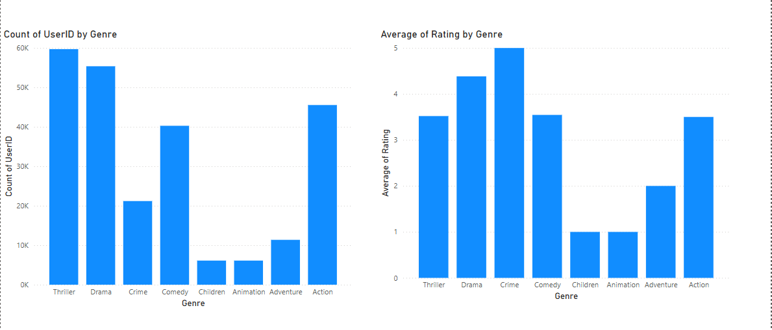
Movie Genre Popularity Report

Slide 36
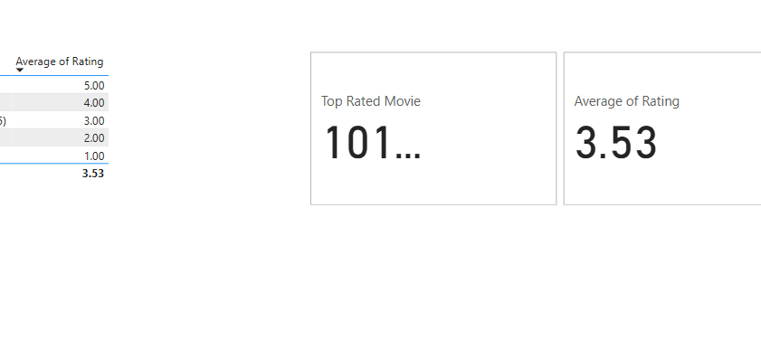
Top-Rated Movies Report

Slide 37
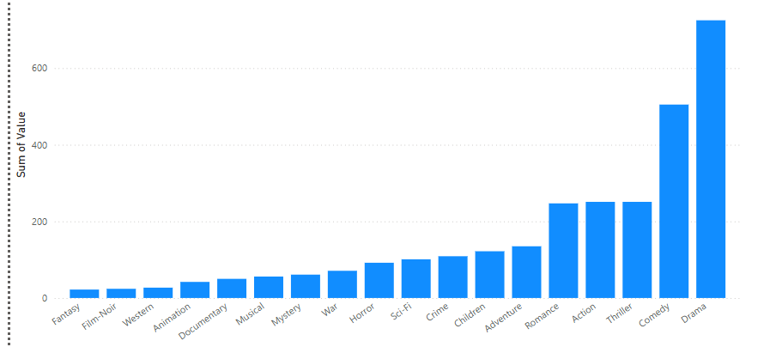
Total Movies per Genre Report

Slide 38

Next Steps: Smarter Movie Picks!
Building upon our MovieLens data exploration, we can leverage the insights gained to develop a more sophisticated recommendation engine.

Slide 39
Building a More Robust Recommendation System: Hybrid Approach
1. Collaborative Filtering:
Utilizes user ratings to find similar users and recommend movies they enjoyed.
2. Content-Based Filtering:
Analyzes movie attributes (genres, actors, directors, plot summaries) to suggest similar movies to those a user has liked.
3. Knowledge Based Recommendation:
Analyzes movie attributes to provide more personalized ratings to those a user has liked.

Slide 40
Adding Layers of Personalization and Context
User Demographics:
Content: Leveraging age, gender, occupation (identified in our analysis) to tailor recommendations.
Example: Suggesting family-friendly movies to users with young children.
Temporal Effects:
Content: Taking movie release dates (as shown in our data) into account to incorporate trends.
Example: Suggesting new releases or movies popular during a specific user's preferred period.
Explicit Feedback:
Allow users to explicitly specify movies they like or dislike.
Impact: Improves recommendation accuracy by focusing on preferences.

Slide 41

Possible enhancements
More data points.
More data makes the model more reliable.
Implementing the model with a robust front end.
Easy interface helps users navigate their favourite movies.
Making it scalable.
Scalability helps with more users at the same time.

Slide 42
Conclusion:
Dataset & Goals
MovieLens dataset: 100K ratings, 943 users, 1,682 movies
Objective: Analyze how age, gender, and occupation influence movie ratings
Business Questions
Most popular movies among different age groups?
Male vs. Female rating preferences?
op-rated genres overall?
Impact of release date on ratings?
How does occupation affect rating behavior?

Slide 43
Conclusion CTND:
ETL (Extract, Transform, Load)
Extract: Converted .dat files (users, items, ratings) to local .csv
Transform:
Cleaned data (remove users <20 ratings)
One-hot encoded genres
Merged datasets for consistency
Load:
Stored in MongoDB for semi-structured access
Used Python scripts to bulk-insert into MS SQL Server
Set up SSAS to define metrics (average ratings, rating counts, etc.)

Slide 44
Conclusion Key Insights & Future Steps
Gender-Based Findings
Females rate Musicals, Children, and Animation higher
Males lean toward Western, Mystery, and Sci-Fi (the difference is moderate)
Occupation-Driven Trends
Students: Largest total number of ratings
Healthcare professionals: Highest ratings per user
Genre preferences vary slightly by profession (e.g., executives → comedy, administrators → drama)

Slide 45
Conclusion Key Insights & Future Steps
Temporal Patterns
Older movies (1930s–1960s) often get higher average ratings
1980s–1990s show a surge in total ratings
Popular titles (e.g., Star Wars) frequently rated above 4.0; Copycat (1995) tops some charts
Challenges & Future Directions
Difficulty normalizing semi-structured data for a relational schema
Plans for a hybrid recommendation engine integrating collaborative filtering, content-based methods, and demographic insights
Demonstrates value of a flexible pipeline (MongoDB + MS SQL + SSAS + Power BI)

